Slide 1
Analysis of new product sales method
An Analysis for Pen and Printers
1

Slide 2
BUSINESS Goals
insight
An analysis that gives a deep understanding of the data and the impact of the sales approach on the customers
SEGmentation
The analysis shows the differences between the customers of different sales method if any exists.
efficiency
The analysis helps in making decision about the sales approach that generates the most sales with the least effort.

Slide 3
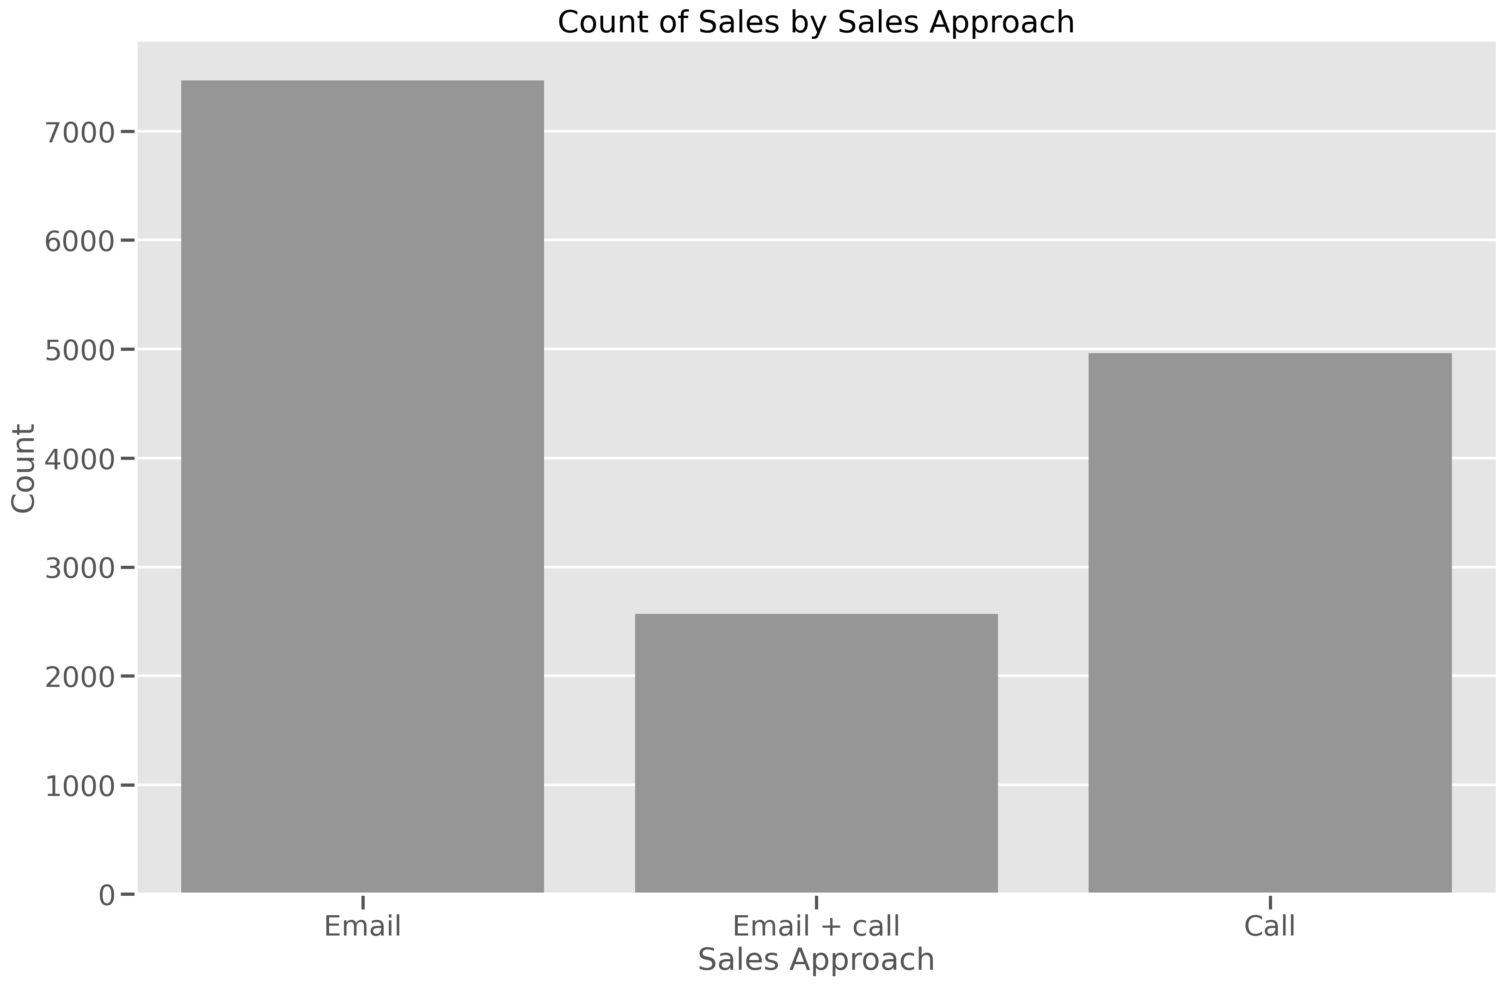
outcomes
A dive into sales strategy – no of sales
A cursory look into sales approach used with customers show that approximately half of the customer were interacted with through email and one third of the customers were interacted with through phone calls and the rest were interacted with through a combination of both method.

Slide 4
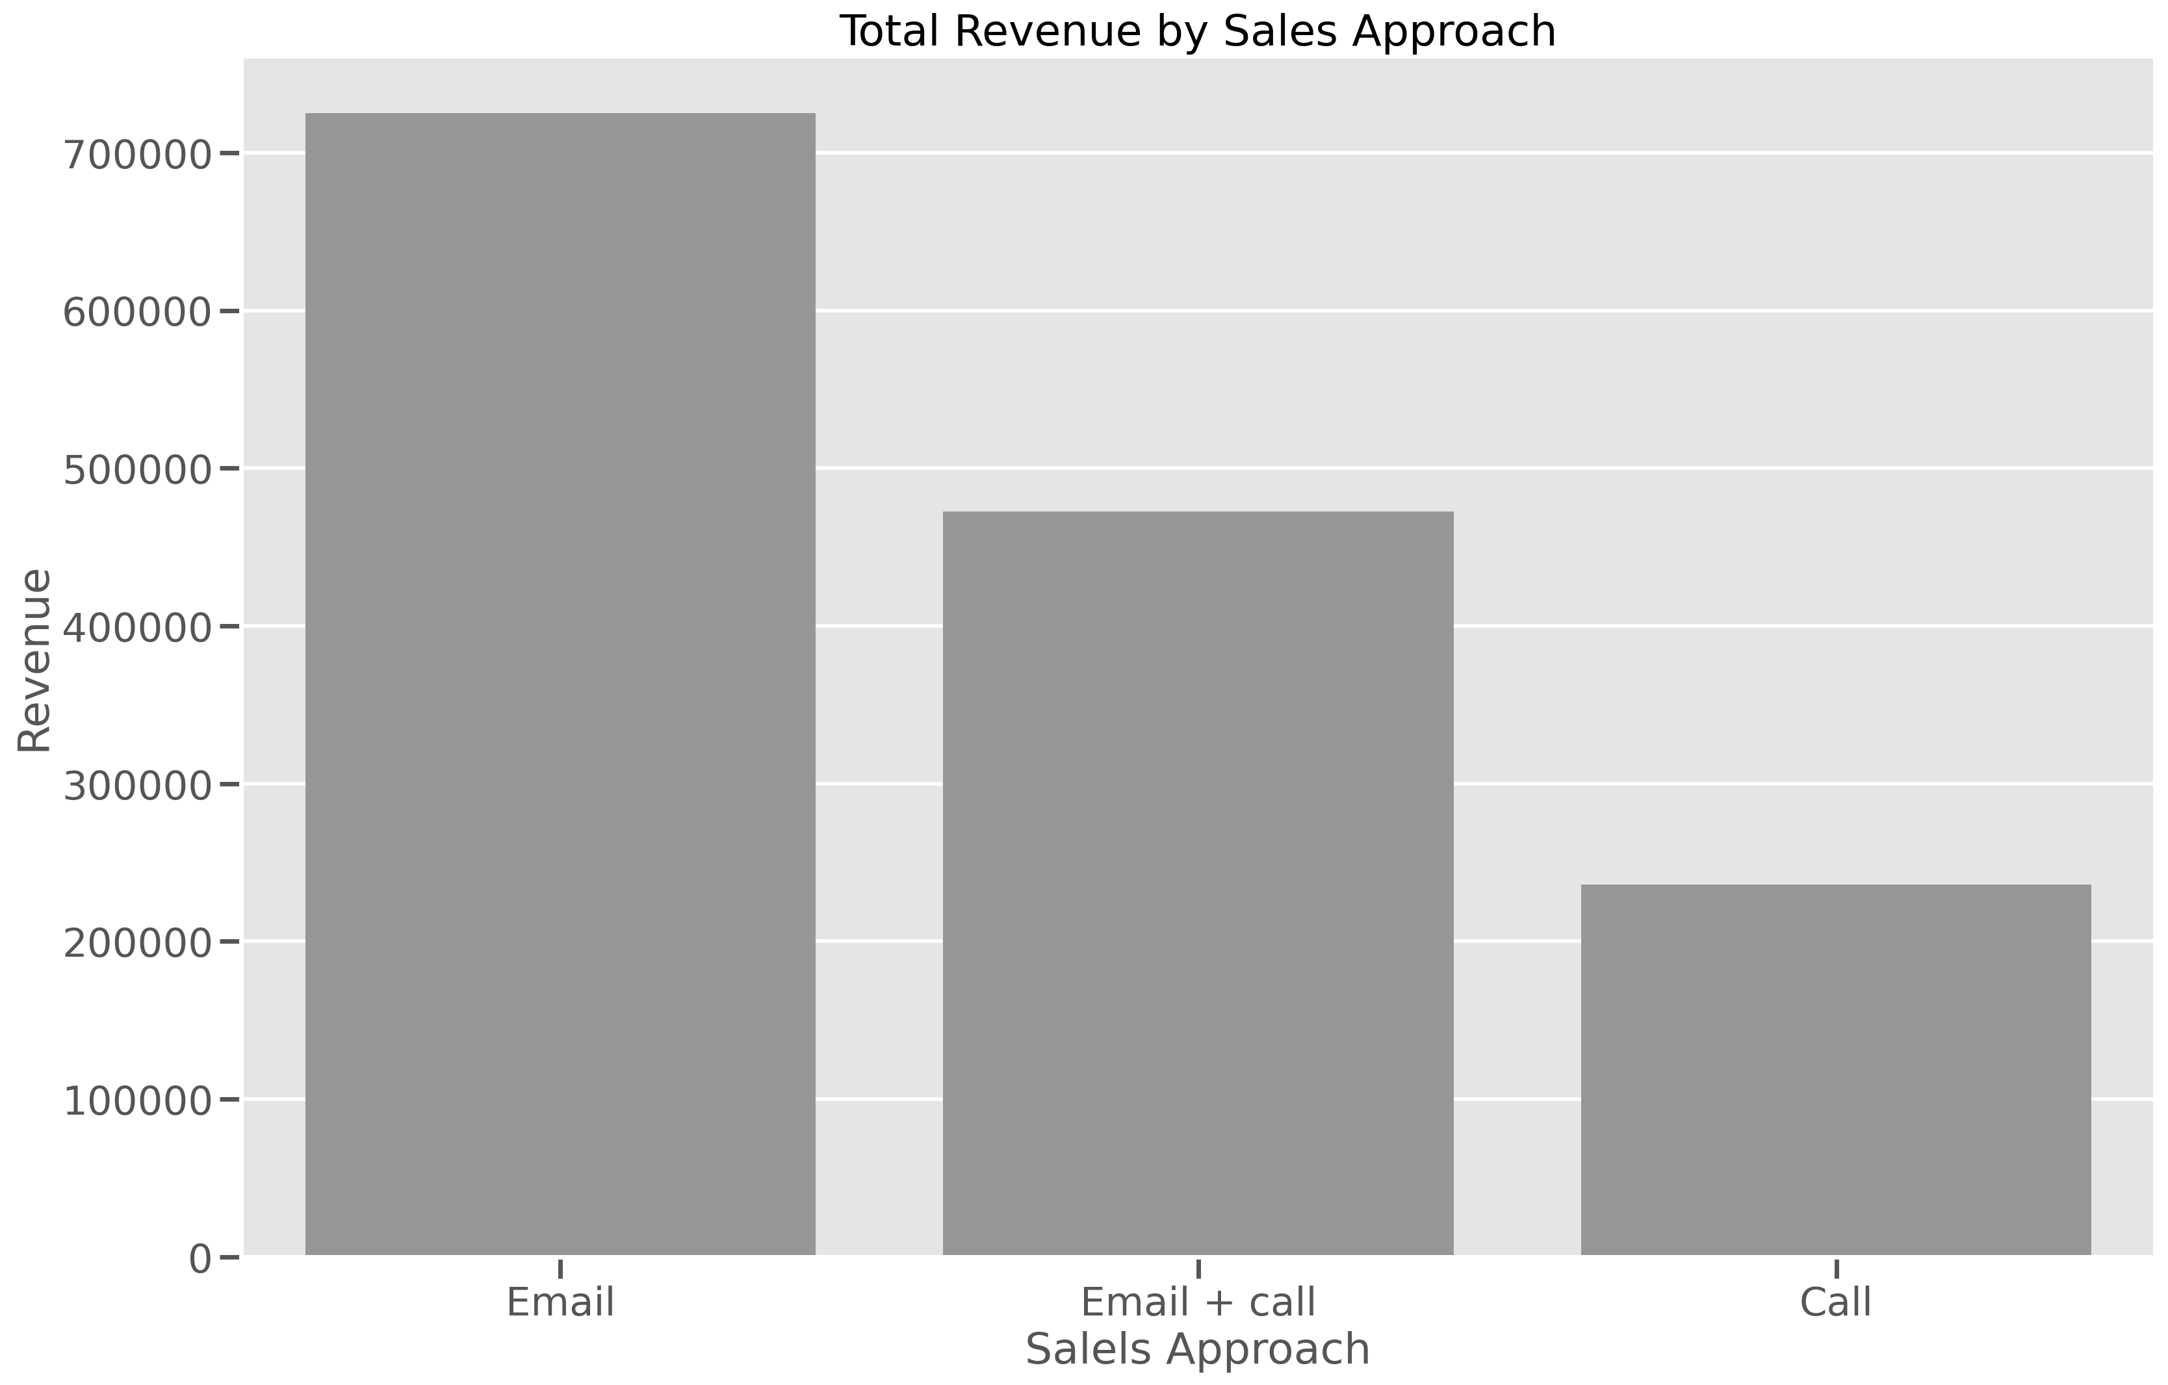
outcomes
A dive into sales strategy - revenue
A deeper dive into each sales strategy shows that while the transaction generated by the combination of both email and call were about 17% the revenue generated by that same method is about 33% of the total revenue

Slide 5
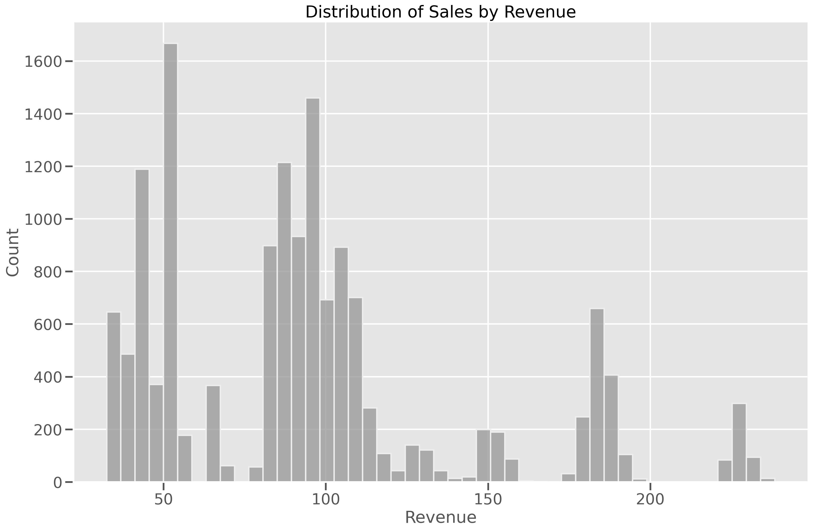
outcomes
A dive into sales strategy - revenue
A look into the distribution of the sales shows that majority of the sales generated less than 140 dollars in revenue

Slide 6
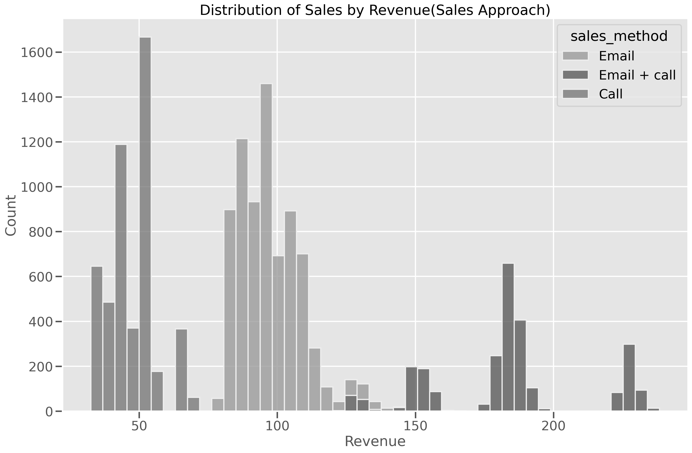
outcomes
A dive into sales strategy - revenue
An insight into the distribution of the sales shows that there are clear segments in the distribution of the sales with sales above 145 are represented solely by Email and call sales approach. A further look shows that sales below 80 are represented by sales approach of using Calls only.

Slide 7
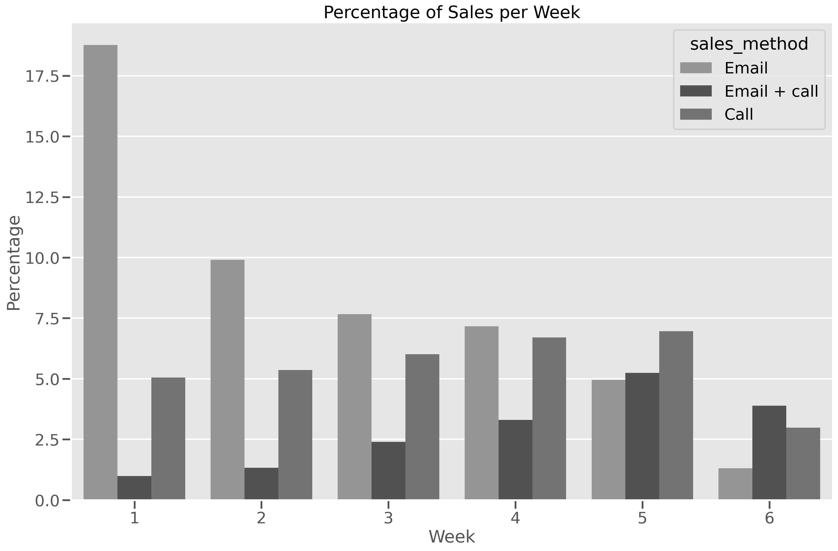
outcomes
Sales generated overtime
The timeline of the sales generated over the course of 6 weeks shows that about a quarter of the sales were made in the first week. The sales over the next 4 weeks shows the sales made in those week were constant with a dip finally in the 6th week only generating about 8% of the total sales.

Slide 8
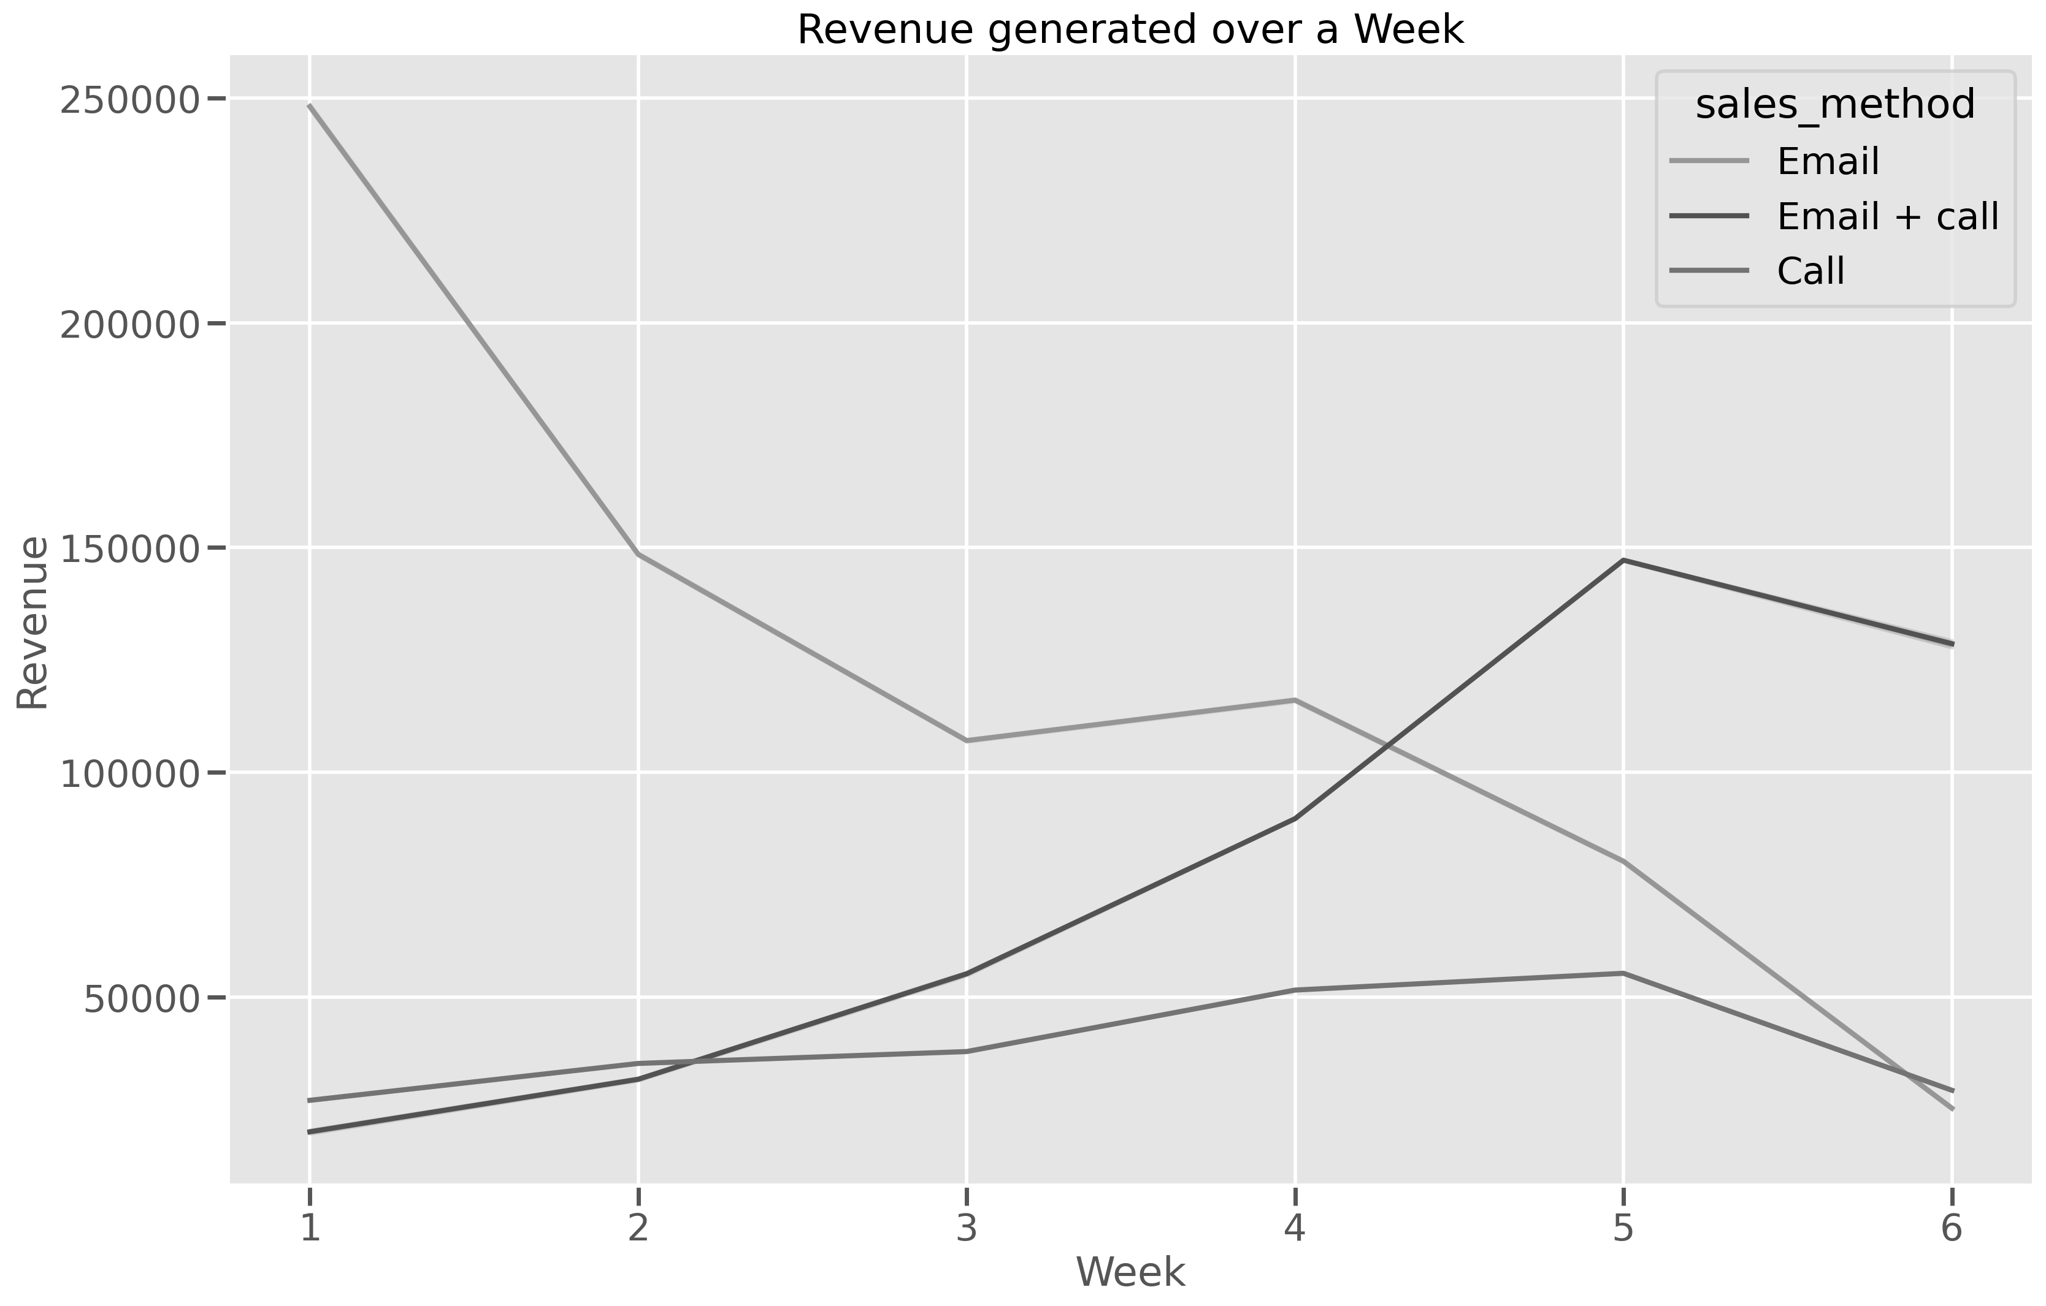
outcomes
Sales generated overtime
The graph present shows changes that occur in terms of revenue with respect to the sales approach. The email approach shows a sharp decrease in revenue generated after the first week, while the others showed an increase in revenue with a dip on the last week of the data.

Slide 9
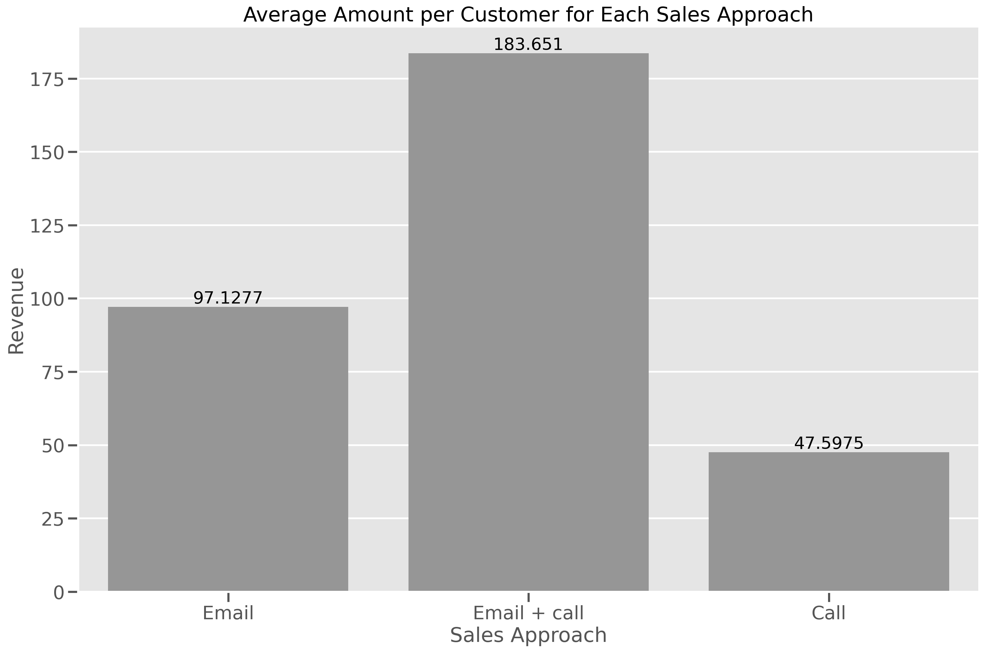
Business metrics
The Email + Call Approach is the best of all the approaches
The business metric selected is the average amount spent by the customers for each sales approach.

Slide 10
Recommendation
For the following weeks and new product lines, I would recommend we focus on the following:
Use the key metric to monitor whether there is any change in the impact of the approach
To increase the percentage of customers the Email + Call approach will be used for
The data collected should in the future endeavour to include the particular product purchased for in-depth analysis into the customer behaviour.

Slide 11
Thank you
Musa Badaru

